Slide 1
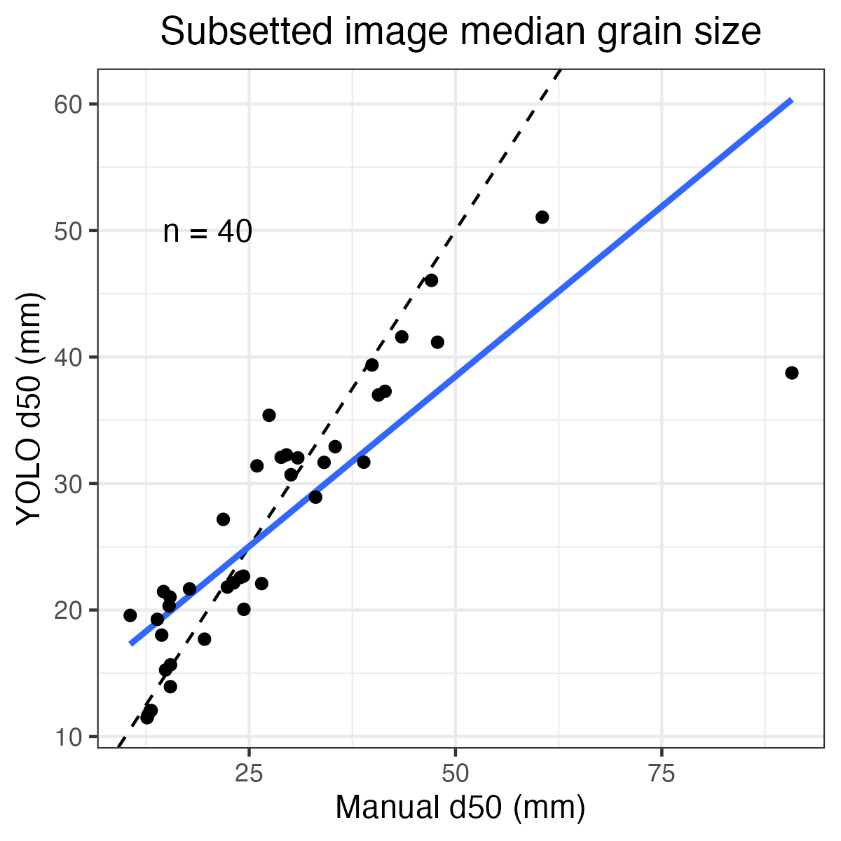
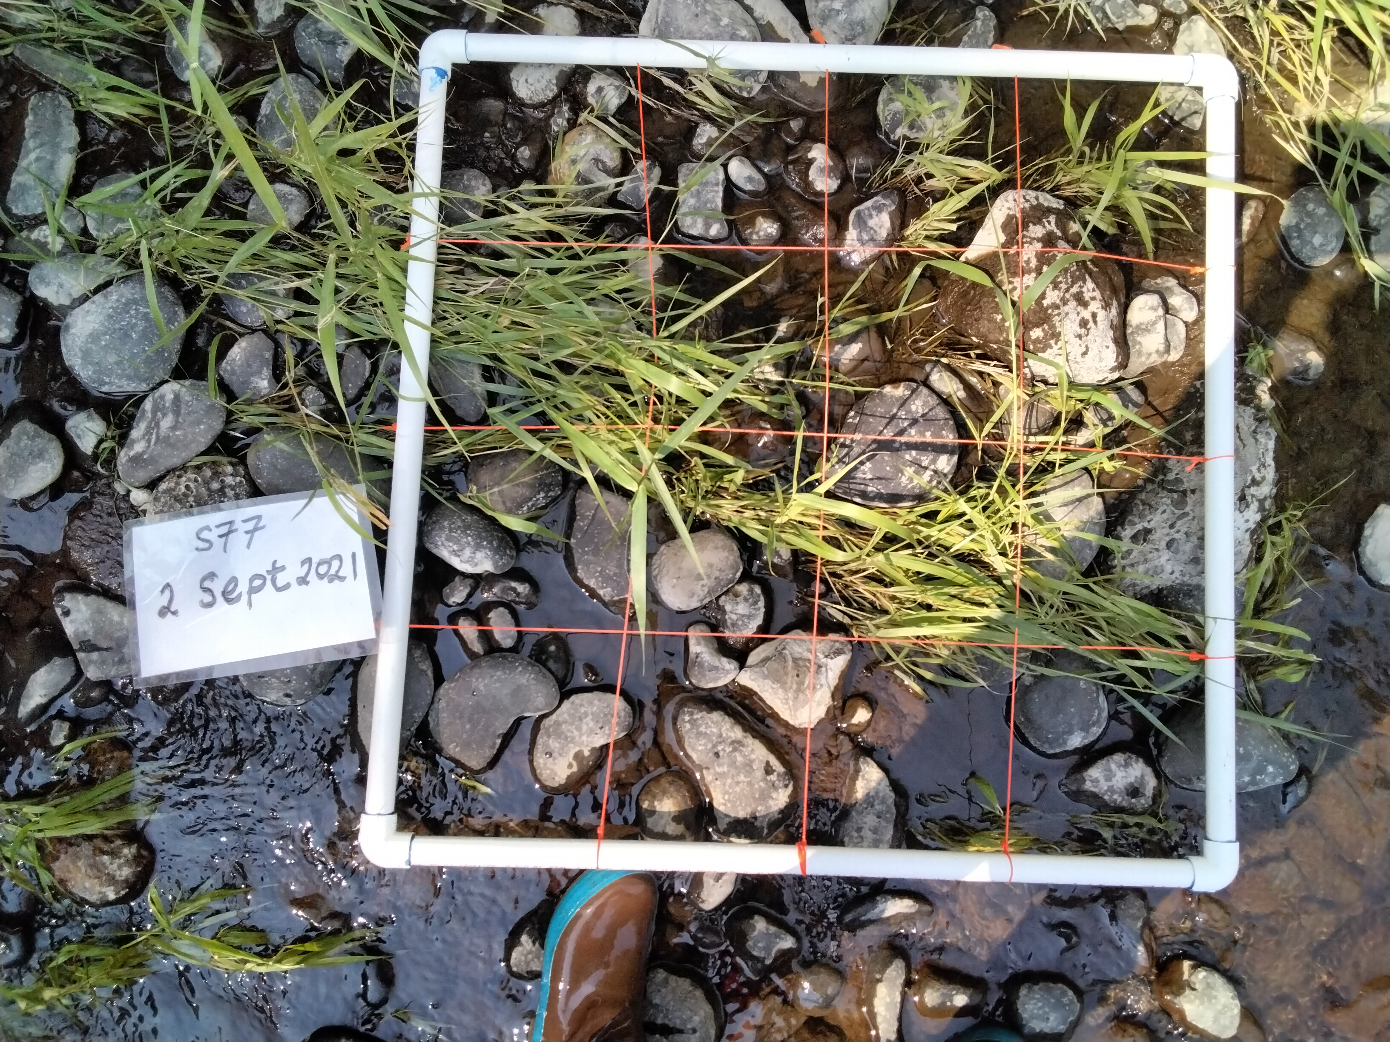

Slide 2
Manual
YOLO
NEXSS and/or Abeshu
D50 (mm)

